Slide 1
AI-Powered Mock Interview System
Team Data Dynamos

Slide 2

The Problem Statement
Students often do not receive enough exposure to real interview environments and lack structured, actionable feedback on their performance, which leads to low confidence and poor preparation during actual placement or recruitment processes.

Slide 3

Our Solution
An Advanced AI-Powered Interview Platform
We simulate real interview scenarios end to-end — from dynamic question generation based on a student's resume or target role, to intelligent response evaluation and detailed, personalised feedback — all in one seamless experience.

Slide 4
Key Features
Resume-Based Questions AI parses the student's resume and dynamically generates role specific, contextual interview questions.
Response Evaluation
AI evaluates answers on clarity, relevance, depth, and communication quality.
Real-Time Simulation Simulates a live interview environment with timed responses and conversational AI interaction.
Detailed Feedback Actionable, structured feedback highlights strengths and areas for improvement after every session.

Slide 5




How It Works
Upload Resume
AI Generates Questions
Student Answers
Receive Feedback

Slide 6






Tech Stack
Backend
Node.js + Express.js — Fast, scalable REST API server handling AI orchestration, user sessions, and data processing.
Database
MongoDB — Flexible NoSQL database storing resumes, session data, questions, and feedback reports.
Frontend
React + React Router + Tailwind CSS — Modern, responsive UI delivering a clean and intuitive interview experience.

Slide 7

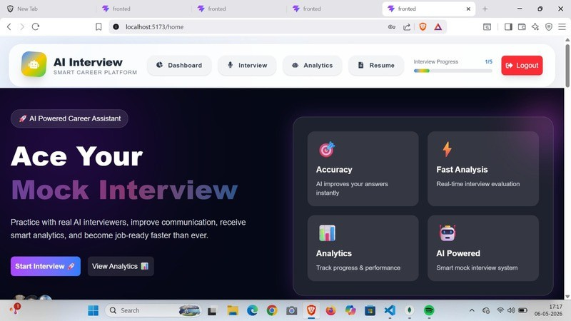
Platform Walkthrough
Home Screen
Student dashboard showing session history, upcoming practice, and quick
start options.

Slide 8

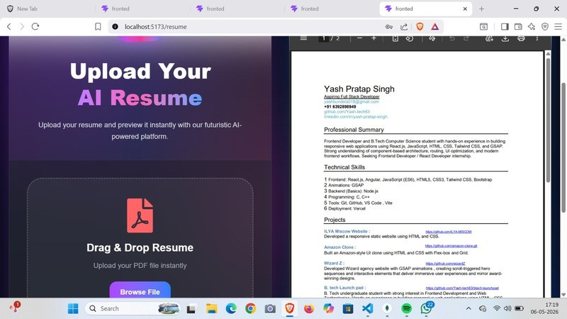
Resume Upload Screen
Upload interface where students submit their CV or select a target job role.

Slide 9

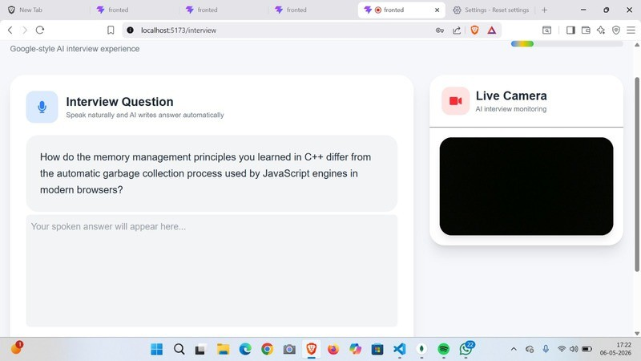
Live Interview Screen
Real-time simulation interface with AI-generated questions and response input.

Slide 10

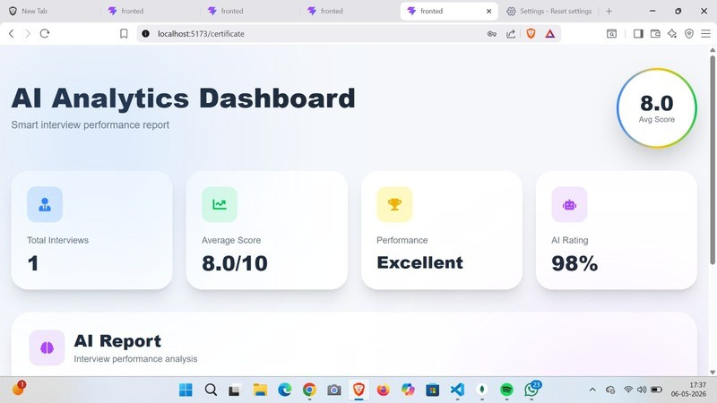
Feedback
Feedback provided after each interview session.

Slide 11

Future Scope
Company packs
Interview modes tailored to specific companies amd job roles.
Progress analytics
Show trends, weak topics, and repeated mistakes.

Slide 12
THANK YOU
Build by Data Dynamos
Team Members Yash Pratap Singh Varsha Rani
Vidhi Upadhyay Ravi Prakash

